Slide 1
Anomaly Detection Dashboard
Final Project

Slide 2
Team
Bill Wilson
Nish Garg
Aditi Sharma

Slide 3
Initial Thoughts
Create a solution which is not product or industry specific
Self Learning and division of work

Slide 4
Technologies Used
ML programming- Python, mpu, scikit-learn
JavaScript – D3, jQuery
UX design: HTML, CSS, Bootstrap
Flask
Heroku

Slide 5
Data Source
https://www.kaggle.com/mlg-ulb/creditcardfraud

Slide 6
Demo
Interactive App

Slide 7

Unsupervised Learning

Slide 8
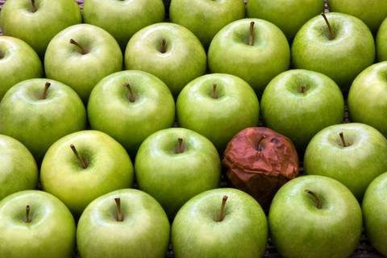

Slide 9


Slide 10


Slide 11


Slide 12


Slide 13


Slide 14
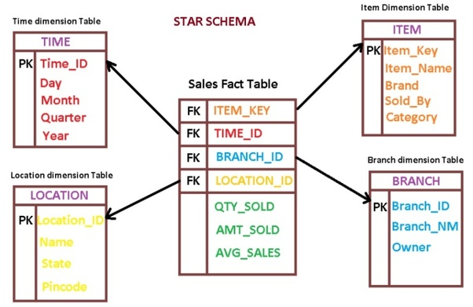
Creating testing data

Slide 15
Detection Outliers in Univariate space
Three Sigma Rule
Median absolute deviation Rule
Boxplot Rule

Slide 16
Detection Outliers in Multivariate space
LOF: Identifying Density-Based Local Outliers
Angle-Based Outlier Detection in High-dimensional Data

Slide 17
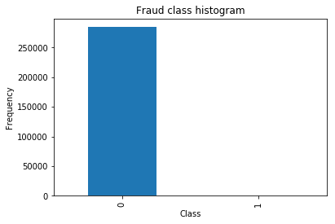
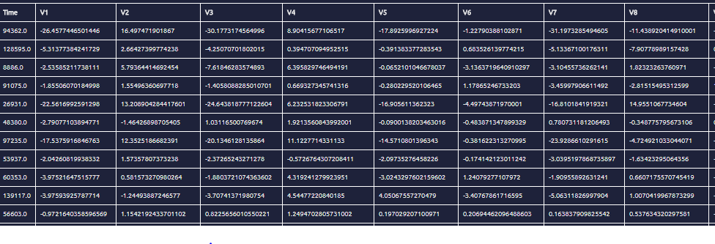
Supervised Learning
Data
Labeled (outlier is 1... normal is 0)
Is Skewed (toward normal)

Slide 18
Supervised Learning
Logistic Regression with undersampling:
Undersampling is reducing the size of the dominate dataset so that it matches the subordinate dataset and then training your model on it.
Positive: emphasizes what makes up the subordinate dataset to the model
Negative: loses emphasis on what makes up the dominate dataset
Accuracy = (TP+TN)/total
Precision = TP/(TP+FP)
Recall = TP/(TP+FN)
Number transactions train undersample dataset: 688 Number transactions test undersample dataset: 296 Total number of undersample transactions: 984 (442 - 0 and 442 - 1)
Train over undersampled training and Predict over undersampled test:
Recall: 0.938775510204

Slide 19
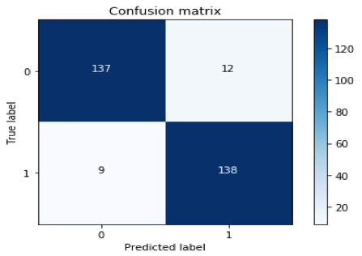
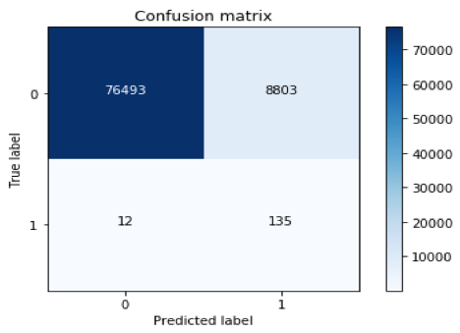

Supervised Learning
Confusion Matrix-1
Confusion Matrix - 2
Confusion Matrix -3
Recall: 0.938775510204
Recall: 0.918367346939
Recall: 0.619047619048

Slide 20

Questions?

Slide 21


